Slide 1
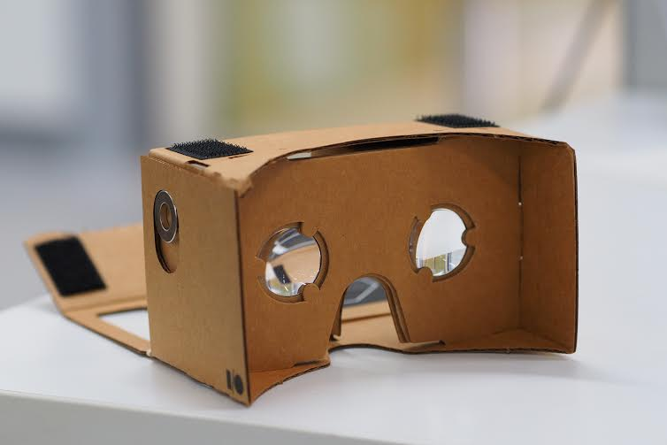

Development of Low Cost Virtual Reality Application
for Indian Heritage Site
B-Tech, CSE
Amity School of Engineering and Technology
June 12, 2017
Under Supervision of
Vivek Sharma
Presented By :
Mohit Gupta 00910420713 Sameek Bajaj 01210402713

Slide 2
Content
Objective
Google Cardboard
Hardware
Software
System Features
Support Features
Complete System Architecture
References

Slide 3
Objective
To develop an android application which acts as a digital guided tour of the remains of heritage site’s in Delhi using audio, images, panoramas, 3D video’s and 4π steradian (360º) video with a mobile smart phone and a Google Cardboard.
Google Cardboard
Virtual reality (VR) platform by Google
The cardboard or viewer is used by placing a smartphone into the back of it and viewing through the lenses in the front
Very low cost as compared to other VR headsets, can even be prepared by user itself

Slide 4
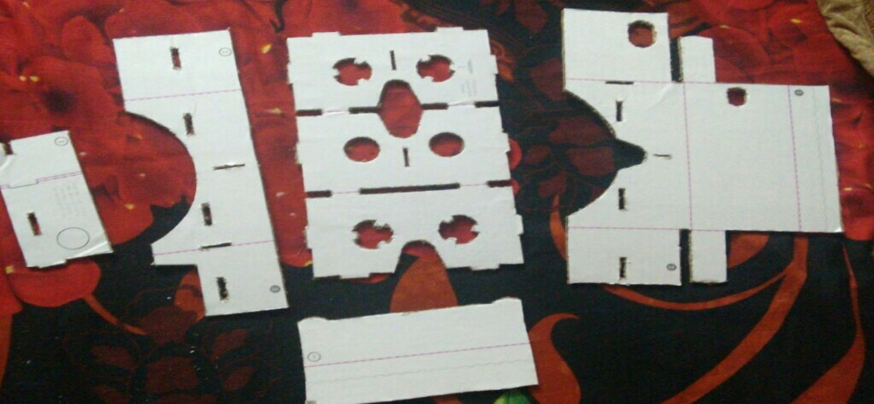
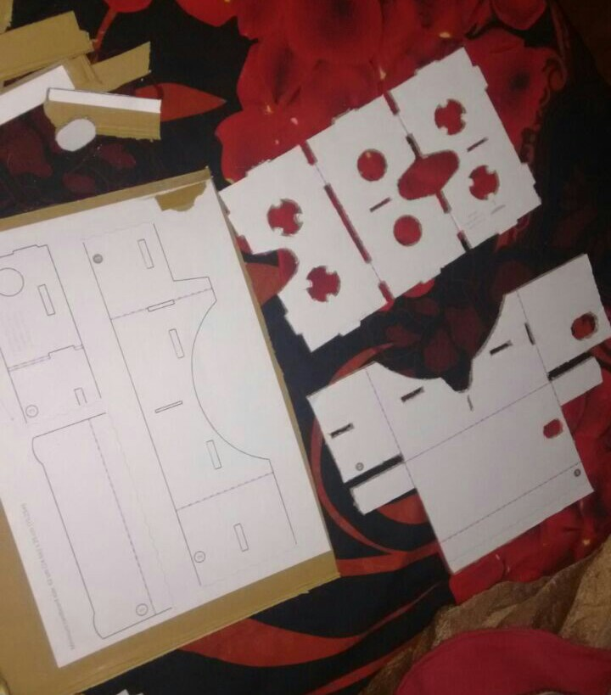
Hardware
Development of Google Cardboard
Hardware Requirement
45 mm focal length lenses
Hook and loop fastener
A rubber band
Optional near field communication (NFC) tag
Figure: Google Cardboard (during assembly process)

Slide 5
Software
Development of Android Application
App will split the smartphone display image into two one for each eye
Applying barrel distortion to each image to counter pincushion distortion from the lenses
A stereoscopic ("3D") image with a wide field of view would be produced
360-degree VR content
Software Requirements
Unity
Figure: Split Screen Depiction

Slide 6
System Features
Panorama Images
360 degree images are incorporated into the system to create real life like environment
Stereoscopic Images
3 dimensional model are depicted in a way that provides analysis of depth perception and curves of the monument
Virtual Tour
3 dimension model is created in which user can navigate with audio and visual aids
Switch from Virtual Reality
User can switch between virtual environment and normal environment

Slide 7
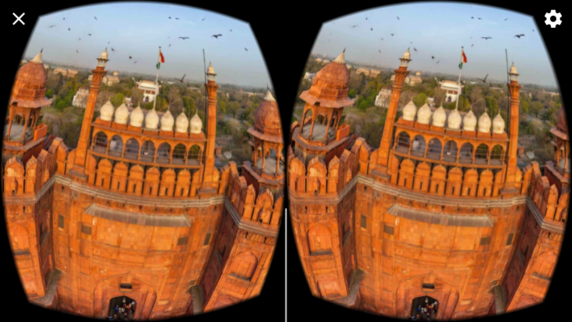
System Features(Cont.)
Panoramic Images
360 degree images are incorporated into the system.
Smartphone’s sensor detect the movement of smartphone
Accordingly shows different parts of the image
Panoramic view is created by placing six different images on 6 faces of cube
GVR camera resides at the center of the cube
Adjusted according to viewers head movement
Figure: Panorama Image of Red Fort

Slide 8
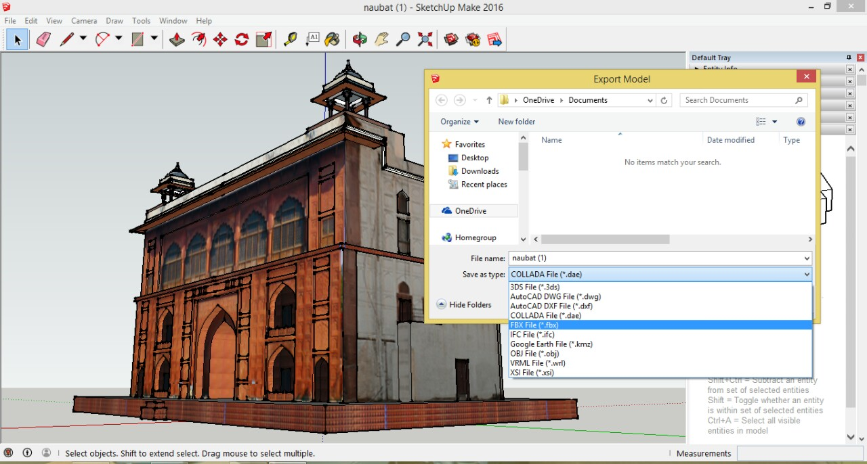
System Features(Cont.)
B) Stereoscopic Images
3 dimensional models are imported into the system
Mutated to recreate the stereoscopic dimensions of the monument exacting the patterns and designs
To create greater analysis of depth perception and curves of the monument
Software Required
Sketchup software
Figure: Sketchup Software Interface

Slide 9
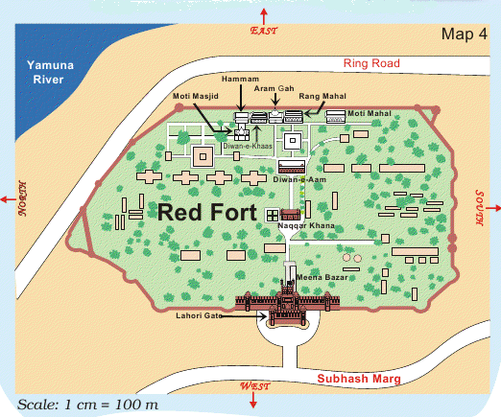
MAP OF RED FORT

Slide 10
System Features(Cont.)
C) Virtual Tour (Technical)
Map of red fort is used to create 3 dimensional virtual model
3 dimensional plane is inserted inside the scene
3 dimensional models are placed at appropriate positions over the 3-D plane
Camera would continuously travel in 3 dimension to create real life experience
C# script will be added to camera in order to do so
Figure: 3 dimensional map of red fort

Slide 11
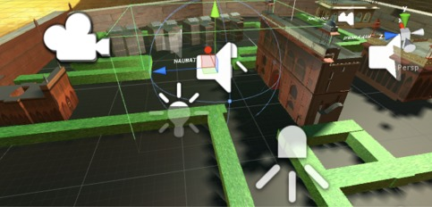
System Features(Cont.)
C) Virtual Tour (Tour Guide)
Audio trails at appropriate positions :-simulating the real life like experience
Unity objects are inserted, audio would only be triggered in these objects
Audio are recorded in Indian accent, for correct pronunciation of names
C sharp scripts are added to objects, so that audio would only be triggered once and only in that region
Figure: Scene with unity object inserted

Slide 12
System Features(Cont.)
D) Switch From Virtual Reality
Feature allows to switch between Virtual environment and normal environment
Allows to target users that does not have google cardboard
Screen change button is inserted in order to do so
Button is inserted in every scene
Figure: Showing the change between normal and virtual environment

Slide 13
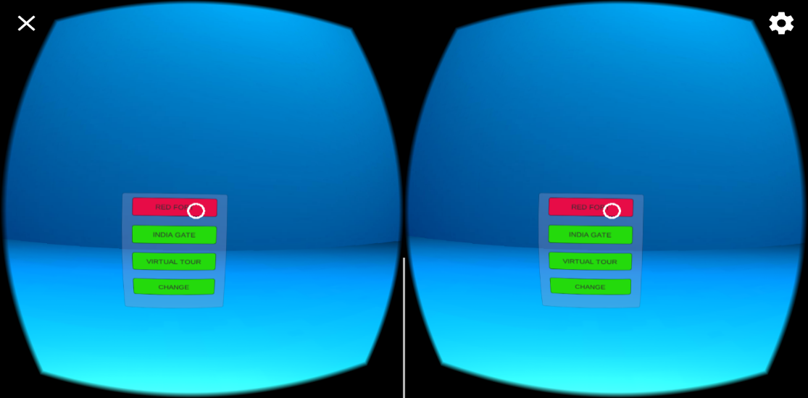
Support Features
GVR Reticle
An alternative of touch trigger at the place where the reticle points
Simulating physical touch irrespective of the touch position on the screen
This can be implemented using materials like sponge, aluminum foil & ruff fiber
B) Audio Trials
Navigational audios are consolidated into the system in every scene
It helps the user to navigate through different components
Informative clips providing paramount details are included in panorama views and virtual tour
Figure: Menu Screen
(Reticle)

Slide 14
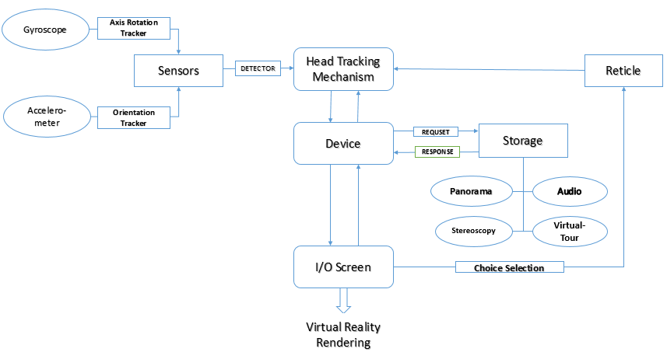
Complete System Architecture

Slide 15
References
McCaffery, John, Alan Miller, Anna Vermehren, and Adeola Fabola. "The Virtual Museums of Caen: A case study on modes of representation of digital historical content." In 2015 Digital Heritage, vol. 2, pp. 541-548. IEEE, 2015
Fabola, Adeola, Alan Miller, and Richard Fawcett. "Exploring the past with Google Cardboard." In 2015 Digital Heritage, vol. 1, pp. 277-284. IEEE, 2015
Davies, Chris, Alan Miller, and Colin Allison. "Mobile cross reality for cultural heritage." In Digital Heritage International Congress (DigitalHeritage), 2013, vol. 1, pp. 331-338. IEEE, 2013
Klahr, Douglas. "Traveling via Rome through the Stereoscope: Reality, Memory, and Virtual Travel." Architectural Histories 4.1 (2016).
Google. Google Cardboard [Online]. Available: https://www.google. com/get/cardboard

Slide 16
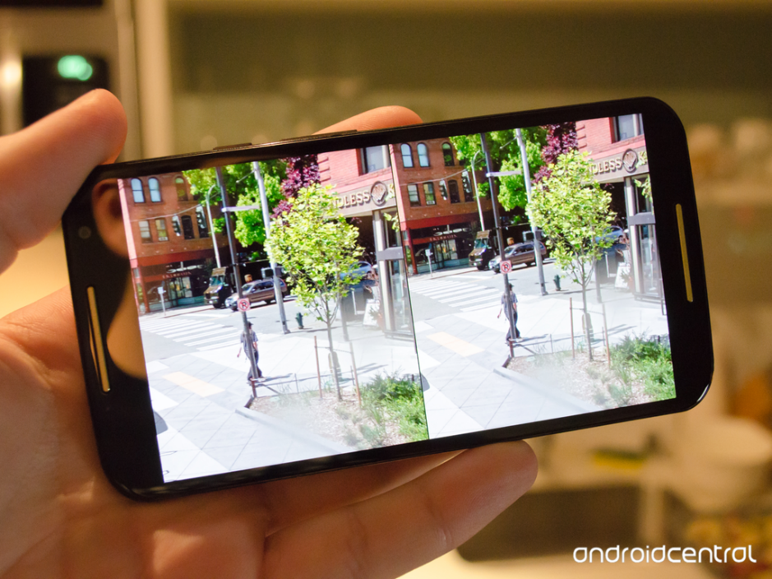
Thank You …

